Slide 1
Standard Club Nominating Committee, Why? and what does it do?
​
Updated to the July 12, 2025 revised standard

Slide 2
AGENDA
Introduction​
Why a Nominating Committee?
When Nomination Meeting is Held
What Happens at the Nomination Meeting
Who gets Nominated
Timeline
Officer/Director/Chairperson Responsibilities
Creating Your Slate of Officer Nominations
​Summary​

Slide 3
Introduction
Annually a Lions Club elects officers. The Standard Club Constitution and By-Laws cover the election of officers and require the current President to appoint a nominating committee. This committee will present, during a nomination meeting, a slate of officer and director nominations to the club for election.

Slide 4
Why does a nominating committee form annually?

Slide 5
Standard Club By-Laws, Article II, Elections and Filling Vacancies, Section 4
“The president shall appoint a nominating committee which shall submit the names of candidates for the various club offices to the club at the nomination meeting. At this meeting, nominations for all offices to be filled in the succeeding year may also be made from the floor.”

Slide 6
Nominating Committee Summary
There are no additional requirements for forming this nominating committee.
The current President appoints committee members annually.
The sole purpose of this committee is to submit for election a slate of officers for the next year at the Nomination Meeting.

Slide 7
When is the nomination meeting held?

Slide 8
Standard Club By-Laws, Article II, Elections and Filling Vacancies, Section 5
“A nomination meeting shall be held in March of each year or as determined by the board of directors, with the date and place of such meeting to be determined by the board of directors. Notice of the meeting shall be published by regular post or electronic means or by personal delivery to each member of this club at least fourteen (14) calendar days prior to the date of the meeting.”

Slide 9
When? Nomination Meeting Summary
This nomination meeting shall be held in March.
When in march does your club meet? Will you use a regular club meeting or special meeting?
Once the board of directors determine the date it should be announced to the club membership at least fourteen (14) calendar days prior.

Slide 10
What happens at the nomination meeting?

Slide 11
Why? Nomination Meeting Summary
The nomination committee submits for election a slate of officers.
At this meeting, and only at this meeting, Nominations for all offices may also be made from the floor at this meeting.
From this meeting a BALLOT of all nominees from BOTH the committee AND THE floor shall be prepared.

Slide 12
What officer are nominated and elected?

Slide 13
Standard Club Constitution, Article VII, Officers, Section 1. Officers
“The officers of this club shall be a president, immediate past president, the vice president(s), secretary, treasurer, membership chairperson, service chairperson, and marketing chairperson..”

Slide 14
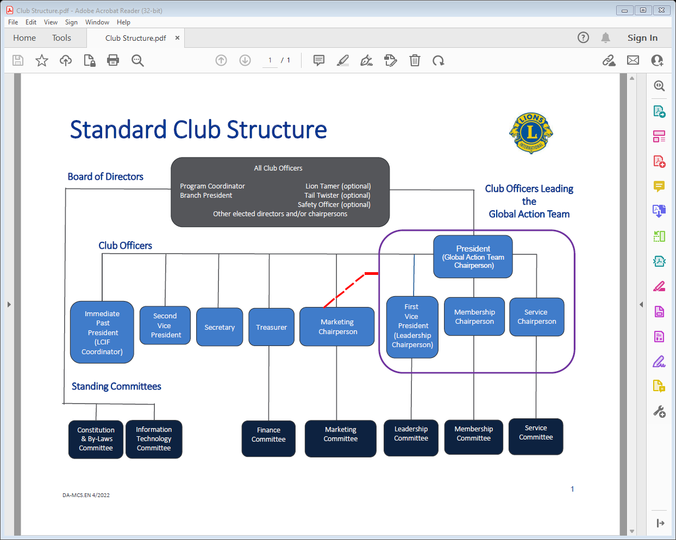

Slide 15
Standard Club By-Laws, Article II, Elections and Filling Vacancies
“The officers of this club, excluding the immediate past president, shall be elected as follows:”

Slide 16
What officers and directors are nominated and elected?

Slide 17
Standard Club Constitution, Article VIII, Board of Directors, Section 1. Members
“The members of the board of directors shall be club officers, Lion tamer (optional), tail twister (optional), club LCIF coordinator, program coordinator, safety officer (optional), branch president, if so designated, Leo Advisor, if so designated and all other elected directors and/or chairpersons.”

Slide 18
Standard Club By-Laws, Article II, Section 2. DIRECTORS ELECTION
“One-half of the directors shall be elected annually and shall take office on the July 1st next following their election, and shall hold office for two (2) years from that time, or until their successors shall have been elected and qualified, with the exception that at the first election held after the adoption of this constitution and by-laws, one half of the directors shall be elected for two year terms and the other one-half of the directors shall be elected for one year terms.”

Slide 19
Standard Club By-Laws, Article III, Duties of Officers, Section 2. Immediate Past President
“They and the other past presidents shall serve as mentors to the club president and vice presidents and serve as the club LCIF coordinator unless another Lion is appointed to this position.”

Slide 20
How many officers does the club have?
From the Standard constitution and by laws - Officers
President – the Global Action Team Chairperson, GAT
1st Vice President – Global Leadership Team Chairperson, GLT
Global Membership Team Chairperson, GMT (2nd VP)
Global Service Team Chairperson, GST (3rd VP)
Secretary
Treasurer
Marketing Chairperson
Immediate Past President (LCIF Coordinator)

Slide 21
Additional Board members to be nominated?
Board of directors
Lion Tamer (optional)
Tail Twister (Optional)
Club LCIF Coordinator (optional, if not the immediate past president)
Program coordinator (required)
Safety officer (optional)
Branch president (if a branch exists and designated)
1st Year club director #1 (optional)
1st year club director #2 (optional)

Slide 22
How many Board members does the club have?
8 Officers plus
Lion Tamer (optional)
Tail Twister (Optional)
Club LCIF Coordinator (optional, if not the immediate past president)
Program coordinator (required)
Safety officer (optional)
Branch president (if a branch exists and designated)
1st Year club director #1 (optional)
1st year club director #2 (optional)
2nd Year Club Director #1 (would serve 2nd year if already elected)
2nd Year club director #2 (would serve 2nd year if already elected)
Others

Slide 23
TIMELINE
January
february
March
April/may
July 1
President forms nominating committee
Nominating committee works on a slate of officers to present while the board of directors sets election date and gives 14-day notice.
Nomination meeting is held - committee presents and nominations from the floor are accepted
Board of Directors announces the candidates and date of election 14 day prior to election is held.
Election held and results are reported
New officers take office

Slide 24
Let’s recap the reasons and answer questions.
The standard club constitution and by-laws presented to Lions Clubs by The International Association of Lions Clubs covers the process for forming a nominating committee and its purpose.
Are there questions?
Next, we will address the Duties of Officers and Directors which should be used to effectively process the nomination of candidates.

Slide 25
ARTICLE III, Duties of Officers

Slide 26
Section 1. PRESIDENT. The responsibilities for this position shall be as follows:
Serve as chief executive officer for this club.
Preside at all meetings of the board of directors of this club.
Chair the Club Global Action Team and ensure the following:
  Ensure the election of qualified Lion leaders for the position of club service chairperson, club membership chairperson and club vice president, who will serve as the leadership chairperson.
  Ensure regular meetings to discuss and advance initiatives established by the Global Action Team.
  Collaborate with the district Global Action Team and other club presidents to further initiatives focused on expanding humanitarian service, leadership development and membership growth.
In collaboration with the club officers and committee chairpersons, implement a plan for membership growth, community engagement, operational improvement and the fulfillment of humanitarian services as presented and approved by the club’s board of directors.
Issue the call for regular meetings and special meetings of the board of directors of this club.
Appoint standing and special committees and cooperate with chairpersons to effect regular functioning and reporting of such committees.
See that regular elections are duly called, noticed and held.
Ensure the club is operating in accordance with local laws.
Ensure proper administration of club operations by ensuring that all club officers and members adhere to the club’s Constitution and By-Laws and the International Constitution and By-Laws.
Encourage diplomacy and solve disputes in a fair and transparent fashion utilizing the Dispute Resolution Procedure if needed.
Be an active member of the district governor’s advisory committee of the zone in which this club is located.
Serve as a mentor to vice presidents to ensure the continuance of effective leadership.

Slide 27
Section 3. FIRST VICE PRESIDENT. The responsibilities for this position shall be as follows:
Conduct an annual club quality assessment and collaborate with the club officers, specifically members of the club’s Global Action Team and other committee chairpersons during his/her term as first vice president to develop a plan for membership growth, community engagement, and the fulfillment of humanitarian services to be presented and approved by the board of directors during his/her term as president.
Serve as a key member of the club’s Global Action Team as the club Leadership Chairperson and along with other members of the leadership committee:
  Ensure that new members are provided with an effective orientation so new members understand how the club operates within its district, multiple district and Lions Clubs International, with the support of the Club Membership Chairperson.
  Ensure current and/or incoming club officers attend training, offered by the district and/or via the Lions Learning Center (LLC)
  Communicate to the District Global Leadership Coordinator the need for training, the names of potential new leaders and the leadership development activities that club members attend.
  Identify potential leaders and encourage their development as future leaders.
  Encourage members to participate in leadership training offered by the district, multiple district and Lions Clubs International.
Take a key role in membership retention and ensure organizational excellence by measuring member satisfaction and utilizing feedback to improve club operations.
Understand the club’s role in district activities and events.
Network with the officers of other clubs to gain ideas that may be applied to the club.
Gain in-depth knowledge of district, multiple district initiatives that support leadership development, membership growth and the expansion of humanitarian service.
Be an active member of the district governor’s advisory committee of the zone in which this club is located.
If the president is unable to perform the duties of his/her office for any reason, the vice president next in rank shall occupy his/her position and perform his/her duties with the same authority as the president.
Oversee the functioning of such committees of this club as the president shall designate.

Slide 28
Section 4. VICE PRESIDENT(S). If the president is unable to perform the duties of his/her office for any reason, the vice president next in rank shall occupy his/her position and perform his/her duties with the same authority as the president. Each vice president shall, under the direction of the president, oversee the functioning of such committees of this club as the president shall designate.
Additional vice presidents are optional
Discuss the use of additional vice president title in conjunction with the GMT and GST
The GAT is now the approach/process being taught by Lions International to create a strong club
Future presidents of the club should gain a working knowledge of the GAT
Assigning the roll of GST or GMT to an individual in line to become president would help develop the training and skills for the position

Slide 29
Section 5. SECRETARY. He/she shall be under the supervision and direction of the president and the board of directors and shall act as the liaison officer between the club and the district (single, sub- and multiple) in which this club is located, and the association. The responsibilities for this position shall be as follows:
Submit regular monthly and other reports to the international office of the association containing such information as may be called for by the board of directors of this association.
Submit to the district governor’s cabinet such reports as it may require.
Be an active member of the district governor’s advisory committee of the zone in which the club is located.
Have custody and keep and maintain general records of this club, including records of minutes of club and board meetings; attendance; committee appointments; elections; member information, addresses and telephone numbers of members; members club accounts.
Give bond for the faithful discharge of his/her office in such sum and with such surety as determined by the board of directors.
Deliver, in a timely manner, at the conclusion of his/her term in office, the general records of the club to his/her successor in office.

Slide 30
Section 6. TREASURER. The responsibilities for this position shall be as follows:
Receive all monies, from the secretary and otherwise, and deposit the same in a bank or banks recommended by the finance committee and approved by the board of directors.
Arrange for issuance, in cooperation with the secretary, quarterly or semi-annual statements to each member for dues and other financial obligations owed to this club and report payments to the Board of Directors.
Pay out monies in payment of club obligations only on authority given by the board of directors.
Have custody and keep and maintain general records of club receipts and disbursements.
Prepare and submit monthly and semi-annual financial reports to the board of directors of this club.
Give bond for the faithful discharge of his/her office in such sum and with such surety as determined by the board of directors.
Deliver, in a timely manner, at the conclusion of his/her term in office, the financial accounts, funds and records of the club to his/her successor in office.
Serves as chairperson for the finance committee.

Slide 31
Section 7. MEMBERSHIP CHAIRPERSON (GMT). The responsibilities for this position shall be as follows:
Serve as a key member of the club’s Global Action Team as the club Membership Chairperson.
Collaborate with the District Global Action Team on membership initiatives, and participate in relevant district, region and zone meetings and events.
Develop and lead a membership committee to help implement action plans to achieve the club’s membership goals and to positively increase the member experience.
Encourage all members to participate in membership growth by inviting prospective members to the club. Follow up with prospective members promptly.
Promote a harmonious club atmosphere by listening to and addressing, with the support of the club board of directors, concerns that prevent a positive member experience. This may include a survey or other opportunities for feedback.
Engage new members in activities that are of interest to the member.
Collaborate with the club service chairperson as well as other club committees to promote membership opportunities.
Understand the different membership types and programs offered and promote membership programs to club members.
Ensure that new members are provided with an effective orientation so new members understand how the club operates within its district, multiple district and Lions Clubs International, with the support of the Club First Vice President/Club Leadership Chairperson.
Attend the district governor’s advisory committee meeting of the zone in which this club is located when appropriate.

Slide 32
Section 8. SERVICE CHAIRPERSON (GST). The responsibilities for this position shall be as follows:
Serve as a key member of the club’s Global Action Team as the club Service Chairperson.
Collaborate with the District Global Service Coordinator, Club LCIF Coordinator, district leaders, members of the club’s service committee and others to develop and communicate annual service goals and action plans. Goals and action plans should address current community needs and / or LCI’s global causes,and can be comprised of advocacy and fundraising in addition to direct service to beneficiaries.
Lead the service committee to implement the club’s service action plans in order to achieve the club’s service goals.
Incorporate opportunities for local youth and Leos to engage in all aspects of service activities, including goal setting, implementation, project evaluation and reporting.
Report service activities to Lions Clubs International.
Serve as a club resource on current community needs by monitoring the service activities of other service clubs, developing community partnerships to expand service, and utilizing tools and resources offered by Lions Clubs International and Lions Clubs International Foundation.
Increase member satisfaction by encouraging participation and engagement in service projects.
Collaborate with the club membership chairperson and other club committees to promote membership opportunities to non-Lions during service projects.
Attend the district governor’s advisory committee meeting of the zone in which this club is located when appropriate.

Slide 33
Section 9. MARKETING CHAIRPERSON. The responsibilities for this position may be as follows:
Develop and implement an annual marketing plan in collaboration with the club membership chair. The plan should consider internal and external audiences, including club members, social media news media, supporters/sponsors and potential new members.
Collaborate directly with the Global Action Team to stay connected to all membership, leadership, and service programs, projects, and events.
Understand global brand guidelines and support proper use of brand materials in club events and service projects.
Promote the work of the club on social media. Develop a social media post calendar to follow club service, community involvement, and membership activities.
Work closely with the club membership chairperson to target and reach out to new potential club members.
Develop club marketing and public relations talking points for club members. Use word of mouth marketing tactics to promote the club and recruit new members.
Working with club leadership, submit marketing award application for consideration for the Lions International Marketing Award
Motivate members to be brand ambassadors. Encourage members to take photos, share on social media, wear brand apparel, and share Lions messages during community involvement opportunities.
Publicize club activities, including service projects, fundraisers, donations, Lions Clubs International sponsored contests and other newsworthy accomplishments both internally and externally via the news media, social media, and other effective means.
Assist the club president in communicating information from the district, multiple district and international headquarters with the club members.
Attend the district governor’s advisory committee meeting of the zone in which this club is located when appropriate.
Participate in meetings held by the district marketing chairperson.

Slide 34
ARTICLE IV, Duties of Directors

Slide 35
Section 1. PROGRAM COORDINATOR (Required).
They improve general meetings and keeps members informed of topics of importance to members by scheduling speakers and entertainment for general meetings based on the interests of club members. The program coordinator obtains permission for speakers from the president, informs the club secretary for inclusion on the agenda and informs the marketing chairperson to ensure effective communication. They welcomes the speaker on arrival and ensures proper seating and welcoming during the event.

Slide 36
Section 2. CLUB LCIF COORDINATOR.
They communicates the mission and success of LCIF and its importance to Lions Clubs International, implements LCIF development strategies within the club and collaborates with LCIF district coordinator to promote LCIF in the local area to ensure alignment with district goals. This position also collaborates with the club service chairperson and the Global Action Team to support club initiatives.

Slide 37
Section 3. SAFETY OFFICER (Optional).
They ensure that safety measures are in place by reviewing activities to identify potential hazards, completing the self-inspection checklist as available from Lions Clubs International, ensuring adequate supervision and acquiring proper insurance coverage. In the event of an incident, they gather and reports all significant information relevant to the incident to the insurance company in a timely manner.

Slide 38
Section 4. LION TAMER (Optional).
The Lion tamer shall have charge of and be responsible for the property and paraphernalia of the club, including flags, banners, gong, gavel. They shall put each in its proper place before each meeting and return the same to the proper storage area after each meeting. They shall act as sergeant-at-arms at meetings, see that those present are properly seated, and distribute bulletins, favors and literature as required at club and board meetings. They shall give special attention to assure that each new member sits with a different group at each meeting so that they can become better acquainted.

Slide 39
Section 5. TAIL TWISTER (Optional).
They shall promote harmony, good fellowship, life and enthusiasm in the meetings through appropriate stunts and games and the judicious imposition of fines on club members. There shall be no ruling from his/her decision in imposing a fine, provided, however, that no fine shall exceed an amount fixed by the board of directors of this club, and no member shall be fined more than twice at any one meeting. The tail twister (optional) may not be fined except by the unanimous vote of all members present. All monies collected by the tail twister (optional) shall be immediately turned over to the treasurer and a receipt be given.

Slide 40
Section 6. DIRECTOR.
He/she provides additional oversight and approval for items placed before the board of directors. The term of office is two-years in duration.

Slide 41
Notes:
Often a large board become difficult to manage. A director could be assigned the duties of optional chairpersons like safety officer, lion tamer or tail twister.
Interviewing club members for suggestions for nominations and to see if a member is interested in a position.
Review the responsibilities for office with candidates. Let club members review them. Something might create interest or avoid discourage leaders because the job was not what was expected.

Slide 42
Summary
The standard club constitution and by-laws presented to Lions Clubs by The International Association of Lions Clubs covers the process for forming a nominating committee and its purpose.
We have explored how and why a nominating committee is formed.
We addressed the Duties of Officers and Directors which should be used to effectively process the nomination of candidates.
The slate of nominees you create and nominations from the floor should be used in creating the ballot for your elections

Slide 43
Questions and
THANK YOU

